Slide 1
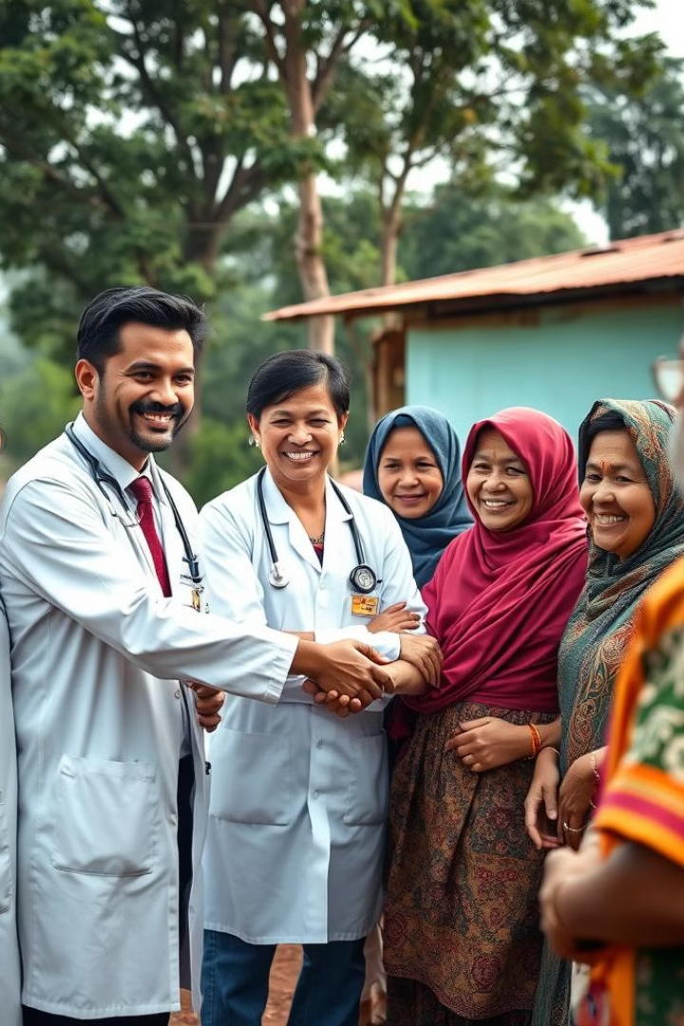

Healthcare Accessibility in Rural Areas
Millions of people living in rural areas around the world lack access to basic healthcare services, leading to disparities in health outcomes and reduced quality of life.
by Tarqueen Jepkoech

Slide 2
Importance of Accessible Healthcare
Access to healthcare is essential for maintaining good health and well-being, enabling individuals to live longer, healthier lives, and contribute meaningfully to their communities.
1
Disease Prevention
2
Early Detection & Treatment
Regular checkups, screenings, and vaccinations can prevent the development and spread of diseases, leading to lower healthcare costs and improved health outcomes.
Prompt diagnosis and treatment of illnesses can significantly improve the chances of recovery and prevent serious complications from arising.
3
Improved Quality of Life
4
Economic Benefits
Access to healthcare allows individuals to manage chronic conditions, receive mental health support, and live more fulfilling lives.
Healthy individuals are more likely to be productive members of society, contributing to the overall economic growth and well-being of their communities.

Slide 3
Barriers to Healthcare Access in Rural Communities
Rural residents face significant challenges in accessing healthcare services, including geographic isolation, limited transportation options, and a shortage of healthcare providers.
Distance & Transportation
Provider Shortage
Rural communities are often spread out, making it difficult and expensive to travel to healthcare facilities, especially for those without personal vehicles.
Rural areas often lack enough doctors, nurses, and other healthcare professionals to meet the needs of the local population, leading to long wait times and limited access to specialized care.
Lack of Infrastructure
Financial Barriers
Rural areas may lack the necessary infrastructure to support healthcare delivery, such as reliable internet access, telecommunications, and adequate healthcare facilities.
Rural residents often have lower incomes than their urban counterparts, making it difficult to afford healthcare services, especially if they require long-distance travel.

Slide 4


Geographical Challenges
Distance and remoteness pose significant challenges to accessing healthcare in rural areas, creating a need for innovative solutions to bridge the gap.
Distance
Infrastructure
Rural communities are often located far from healthcare facilities, requiring long and inconvenient commutes.
Lack of paved roads, bridges, and other essential infrastructure can make it difficult to access healthcare facilities, especially during inclement weather.
1
2
3
Transportation
Limited public transportation options in rural areas make it difficult for people to get to healthcare appointments, especially for those who cannot drive.

Slide 5
Socioeconomic Factors
Income inequality, educational disparities, and cultural barriers contribute to healthcare disparities between rural and urban communities.
Income
Education
Cultural Barriers
Lower incomes in rural areas can make it difficult to afford healthcare services, leading to delayed or forgone care.
Limited access to quality education in rural areas can contribute to lower health literacy rates and make it challenging for individuals to understand and manage their health.
Cultural beliefs and practices can sometimes hinder individuals from seeking healthcare, resulting in delays in diagnosis and treatment.

Slide 6
Current Healthcare Delivery Models in Rural Areas
Traditional healthcare delivery models in rural areas often face challenges in meeting the needs of the local population, leading to the exploration of new and innovative approaches.
Model
Description
Advantages
Disadvantages
Community Health Centers
Provide primary care and essential services to underserved communities.
Increased access to affordable healthcare, improved health outcomes.
Limited resources, challenges with attracting and retaining qualified providers.
Telemedicine
Leverages technology to provide remote healthcare services, including consultations and monitoring.
Increased access to specialized care, reduced travel time.
Requires reliable internet access and technology, concerns about privacy and security.
Mobile Clinics
Provide healthcare services to remote communities through mobile units.
Improved access to healthcare in underserved areas, reduced travel time.
Limited services, logistical challenges with maintaining mobile clinics.

Slide 7




Innovative Approaches to Improving Rural Healthcare Access
Innovative approaches to rural healthcare delivery are essential to address the unique challenges faced by these communities, ensuring equitable access to essential services.
Telehealth Expansion
Expanding access to telemedicine services can bridge the gap in access to specialized care, allowing rural residents to connect with specialists remotely.
Community Health Worker Programs
Training local residents as community health workers can provide valuable support and education, fostering a sense of ownership and community health.
Mobile Medical Units
Deploying mobile medical units to reach remote communities can provide essential healthcare services to those who have limited access to traditional clinics.
Incentivizing Providers
Offering financial incentives and loan forgiveness programs can attract and retain healthcare providers in rural areas, addressing the shortage of medical professionals.

Slide 8
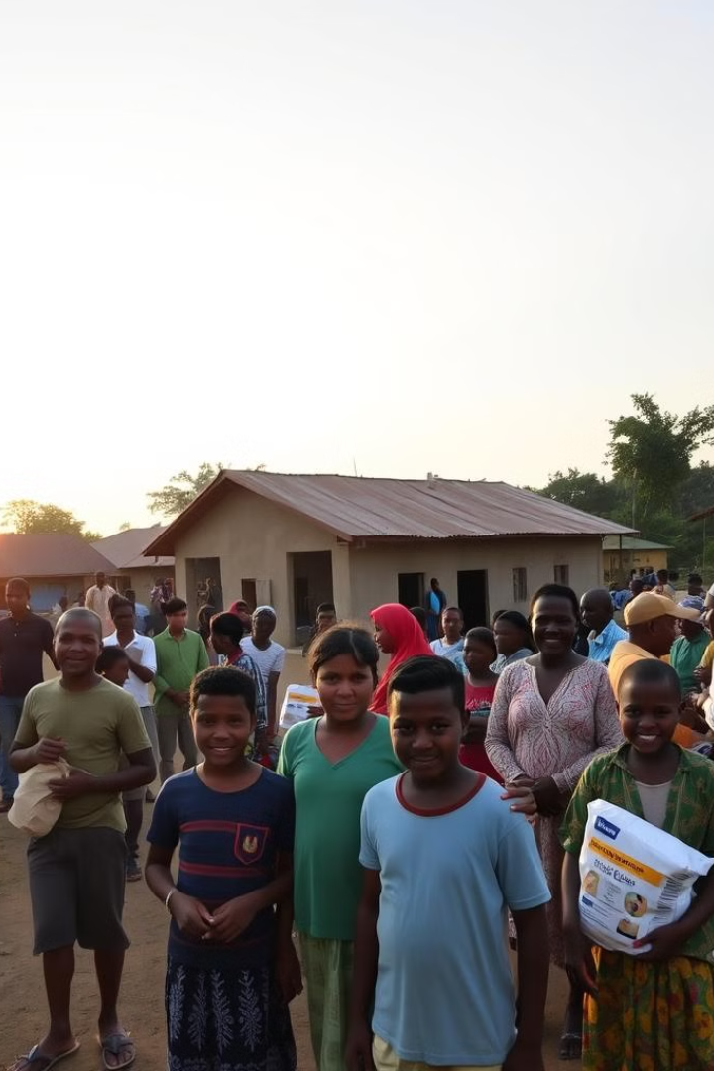




Conclusion & Recommendations
Addressing the challenges of healthcare accessibility in rural areas requires a multifaceted approach that includes investing in infrastructure, technology, and innovative healthcare delivery models.
Improve Infrastructure
Expand Telehealth
Investing in roads, bridges, and other essential infrastructure can improve access to healthcare facilities, especially in remote areas.
Expanding access to telemedicine services can bring specialized care to rural communities, reducing the need for long-distance travel.
Financial Incentives
Community Engagement
Providing financial incentives and loan forgiveness programs can attract and retain qualified healthcare providers in rural areas.
Engaging with local communities can foster a sense of ownership and partnership in improving healthcare access and outcomes.

